Slide 1
Understanding the Behaviors and Motivations Behind a Sedentary Lifestyle : Design Concept
HCI 516
Group 4
Gabriel Castro | Jordyn Smith | Saman Kamran | Taylor Brandon

Slide 2
Prioritization
We decided to select stage 3 and utilize the user's network and their need to improve their behavior as a form of motivation:
We felt this stage required low effort for a higher impact
Giving people who are already motivated a way to change their behavior can be effective as we are attempting to give a structured way to track their progress
People who are aware of their problem and don't know where start can also see what the motivated users are using and try it for themselves

Slide 3
Prioritization
The Stakeholder/systems required:
Developers to make the tool
Workplace/academic institution willing to implement the tool
The Audience targeted:
The end user, specifically people in the workplace (remote or in-person).

Slide 4
Prototype
Objective:
Help those that are interested in reducing their sedentary behavior with building a habit of taking frequent breaks from sitting
Prototype uses a gamification to motivate users
Target Behavior desired:
User is regularly taking breaks and getting long streaks
Planning their work around taking breaks to move
Decision Levers Leveraged:
Cues, habit building, goal alignment.
Using influencers like friends/colleagues

Slide 5
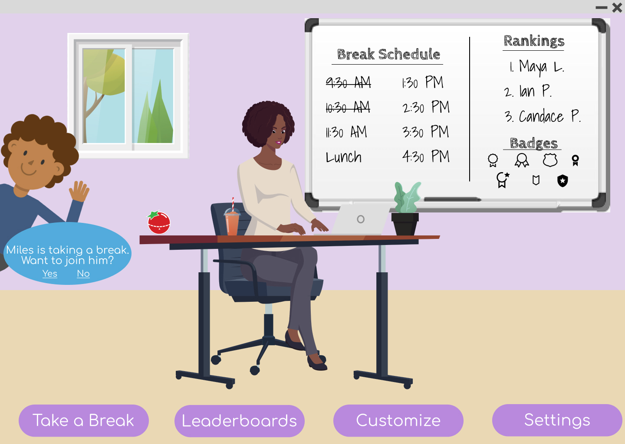
High Fidelity Dashboard
Dashboard
From the dashboard, users will get a bird's eye view of the desktop app. Users can see their own break schedule, their place in the leaderboards, and achievements they've earned at a glance.
Users can also see their own customized avatar and view alerts they get within the desktop app.
Tracks breaks. User can edit
Top 3 on leaderboard – highest break streak, total number of minutes etc., the user can select how they want to view this
Interactive – setting changes throughout the day
Badges users have earned for their progress
Customizable avatar and office space. User gets new decorative elements as needed.
In-app notification pop-up
Can edit how they want their goals to be set up, how often they need reminders, etc.

Slide 6
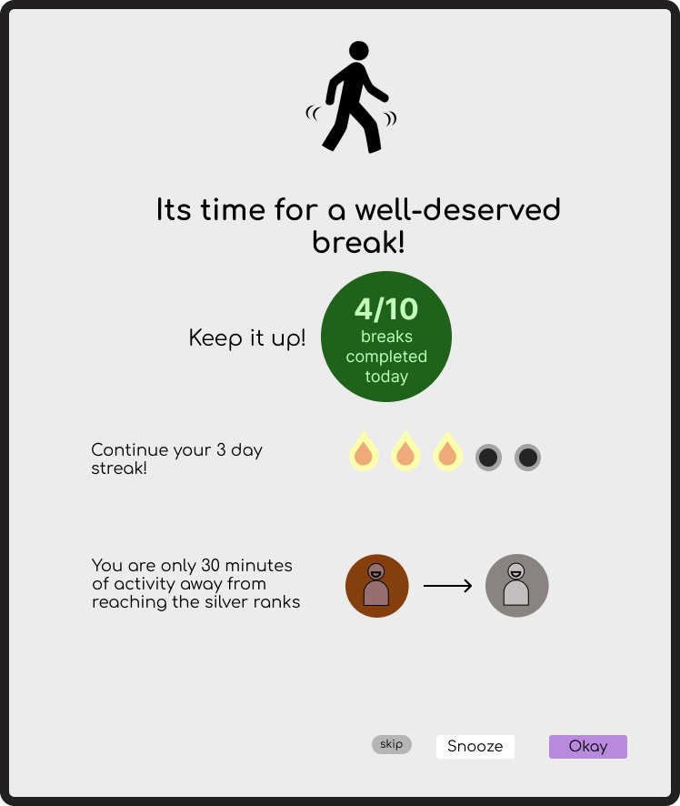

Reminder - Disruptive
Disruptive Reminder
User can select if they want to have a disruptive reminder. This locks their screen for a set time.
User can see their current progress of how many breaks they took today
Shows the daily progress streak. A streak is counted only when the day goals are completed.
Shows current place of the user in the leaderboard
Snooze period can be set by the user in the settings

Slide 7
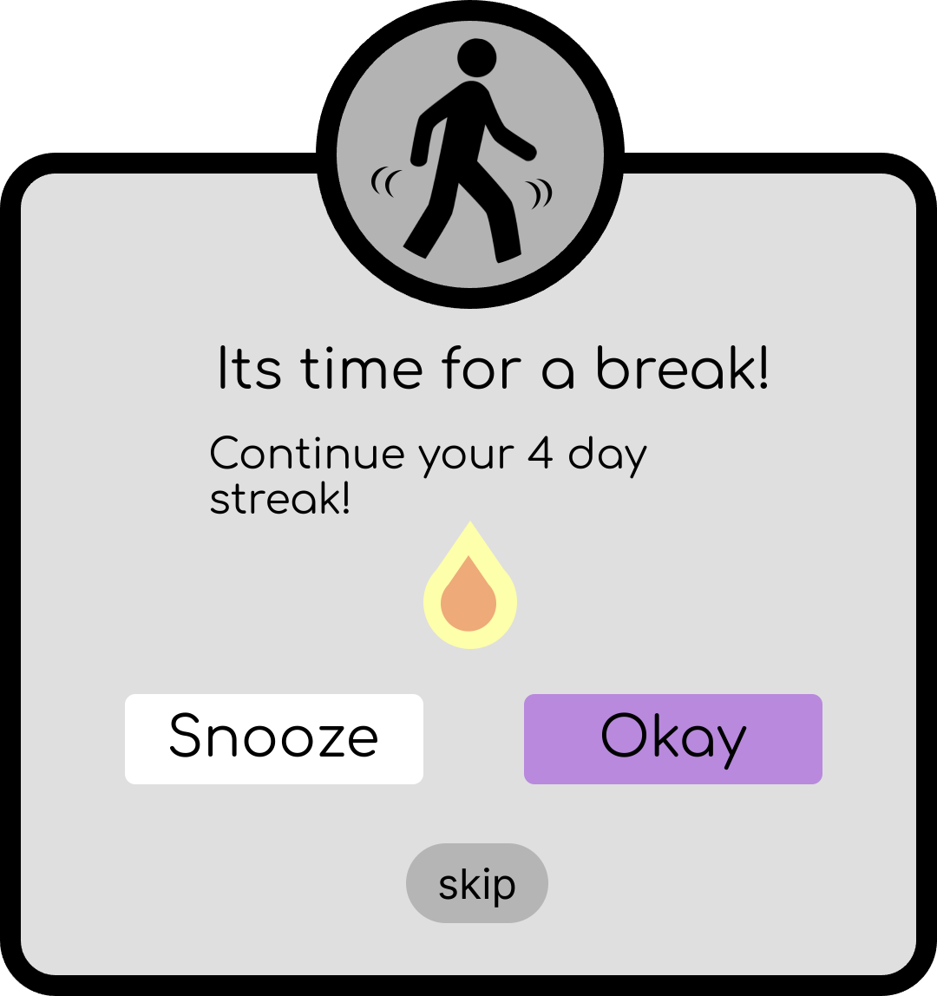
Reminder – Non-disruptive
Non-Disruptive Reminder
With non-disruptive reminders, users can receive notifications to remember to take a break, while also having the freedom to choose to take a break. Non-disruptive reminders can encourage users to make the active decision to stand up.
This pop-up is non disruptive. User can change the settings,

Slide 8
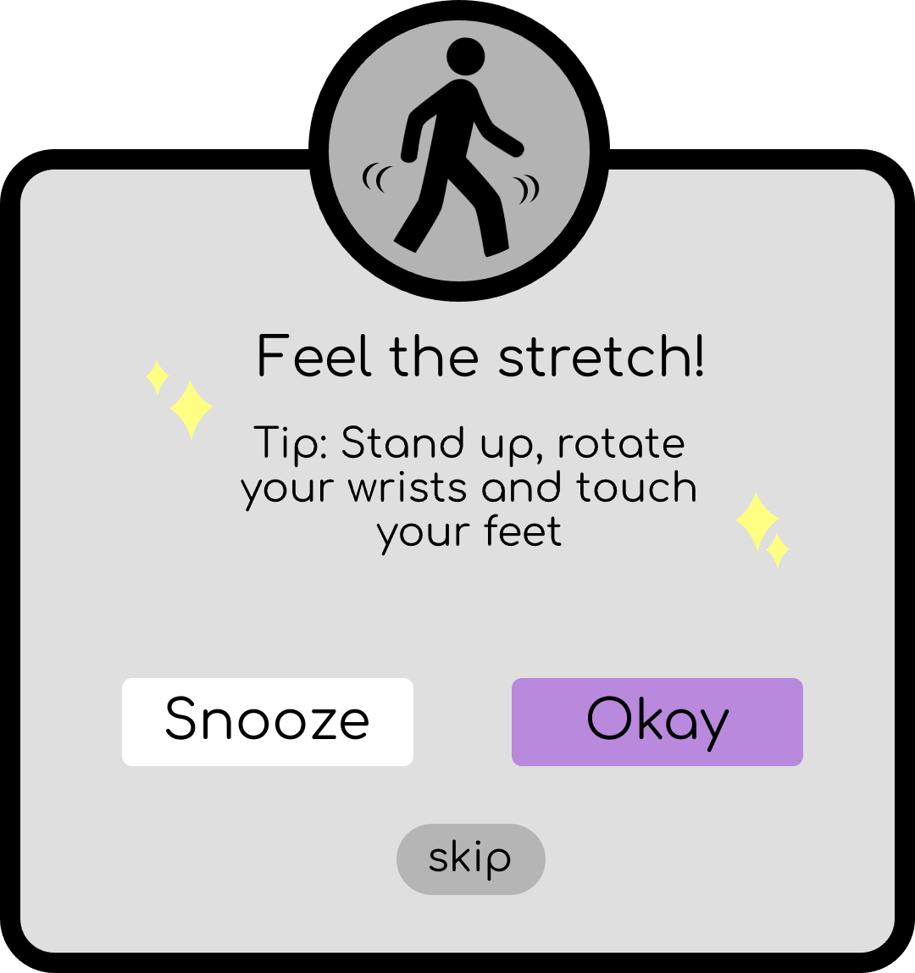
Reminder – Non-disruptive
More motivation using simple tips to help them move.

Slide 9
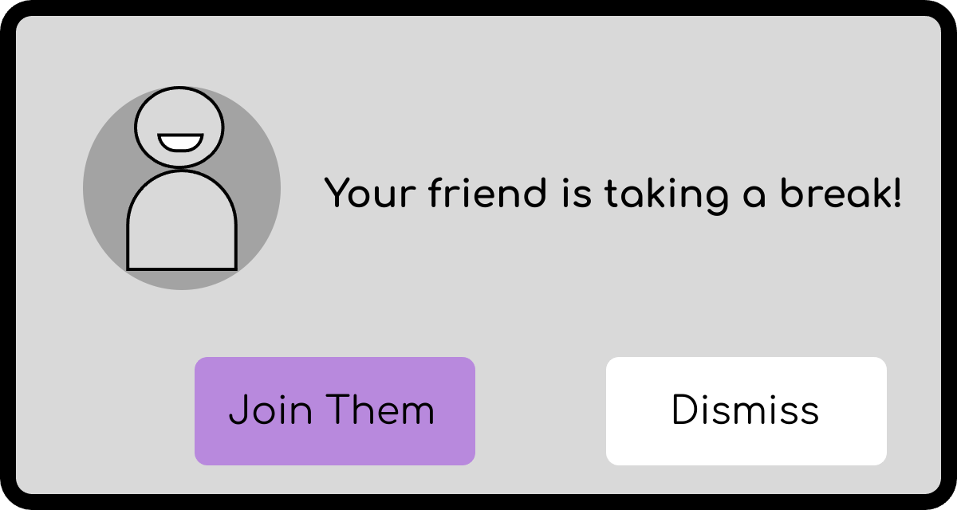
Motivation through Friends/Colleagues
Friend alerts
We decided to leverage a user's reference network by designing Friend Alerts. With friend alerts, users can receive notifications when one of their friends is taking a break. Seeing their friend taking a break can help motivate users to take a break as well.
Non-disruptive pop-up that notifies user when their friend is taking a break.

Slide 10
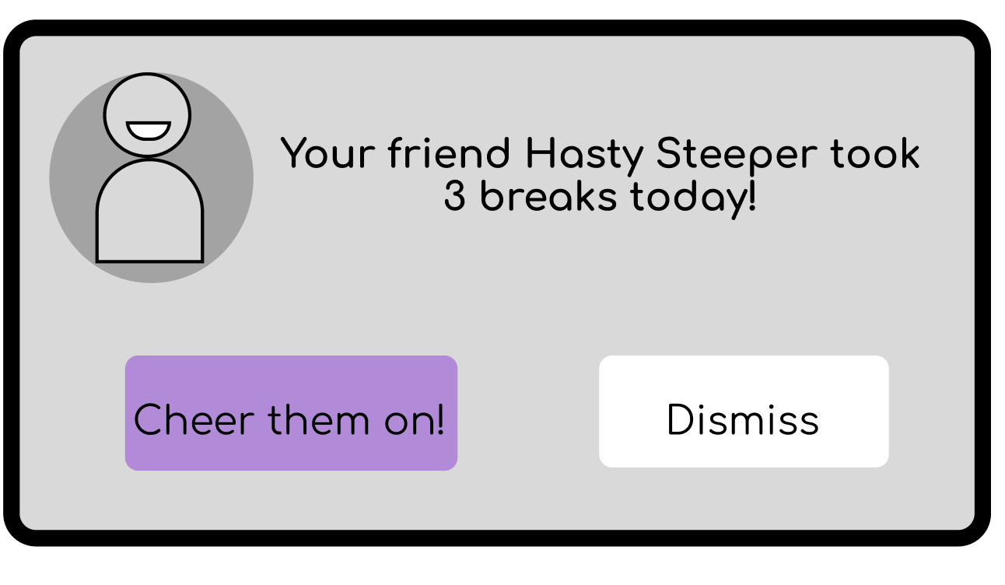
Motivation through Friends/Colleagues
Send their friend a congratulations comment on their achievement.

Slide 11
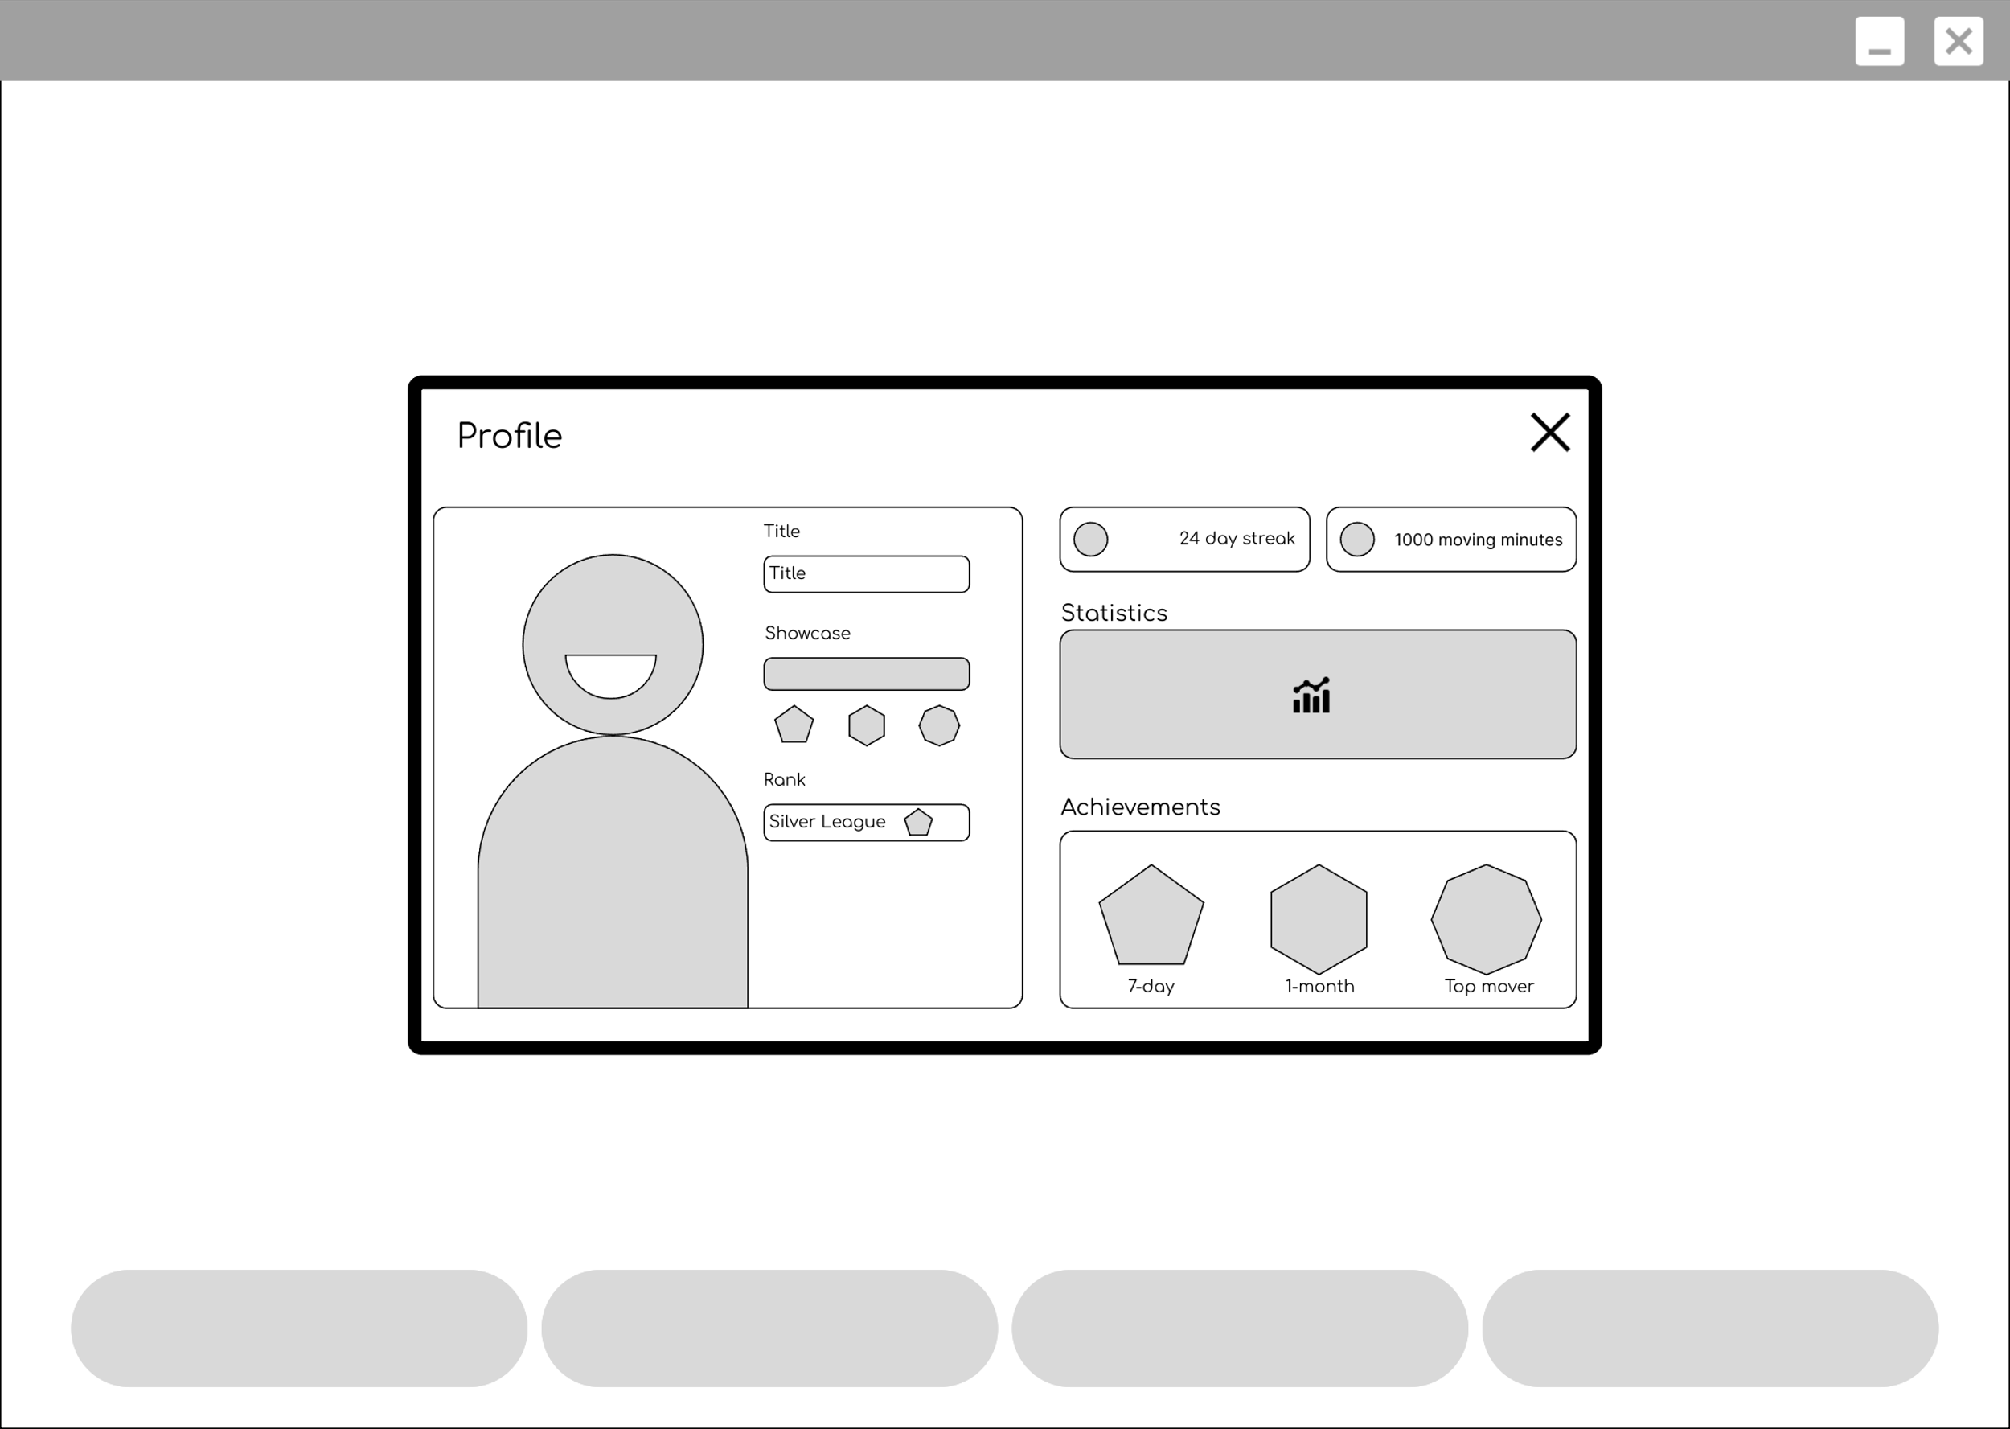
Profile
Profile, avatars, titles, and achievements
This profile card will open when the user clicks on their own avatar. The user can get a deeper view of their profile, achievements, and movement streaks. Seeing how far they've come on their journey can help motivate users to stay on track.
User can collect badges and achievements for various milestones

Slide 12
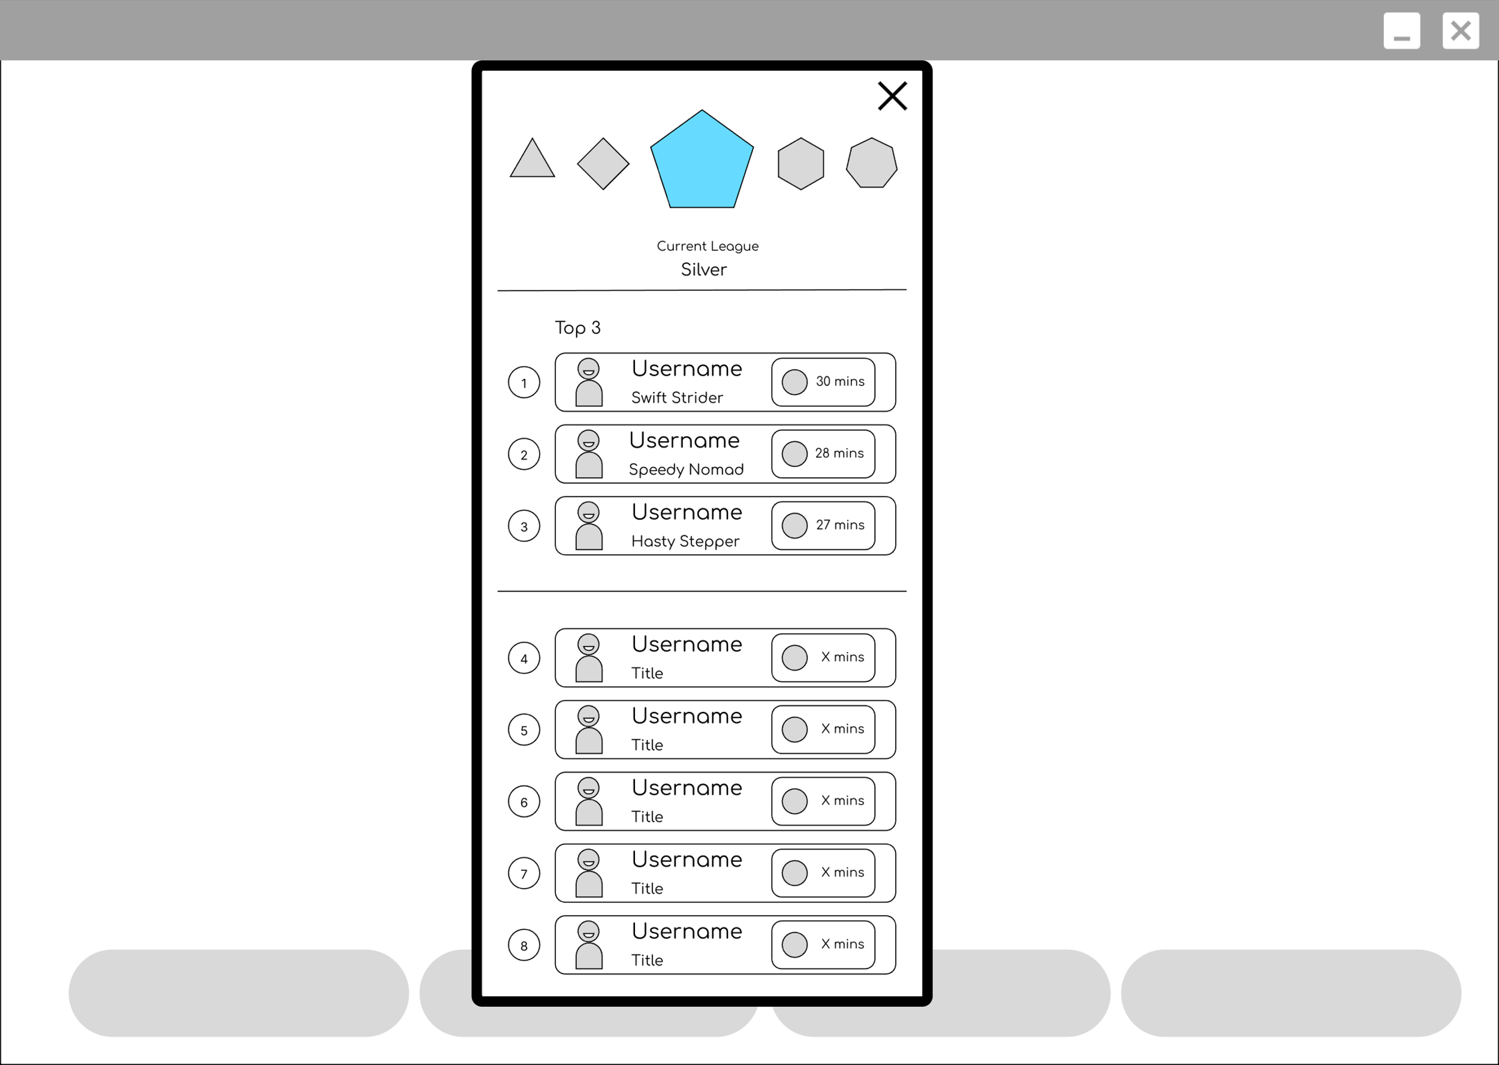
Leaderboard
Leaderboards
The leaderboard leverages a user's social network to help keep them motivated while staying on track. Leaderboards show the current "rank" users are in. Other users in the same rank compete against each other to move to the next league.
User profiles
Shows username, title, and current movement minutes/streaks for the week

Slide 13
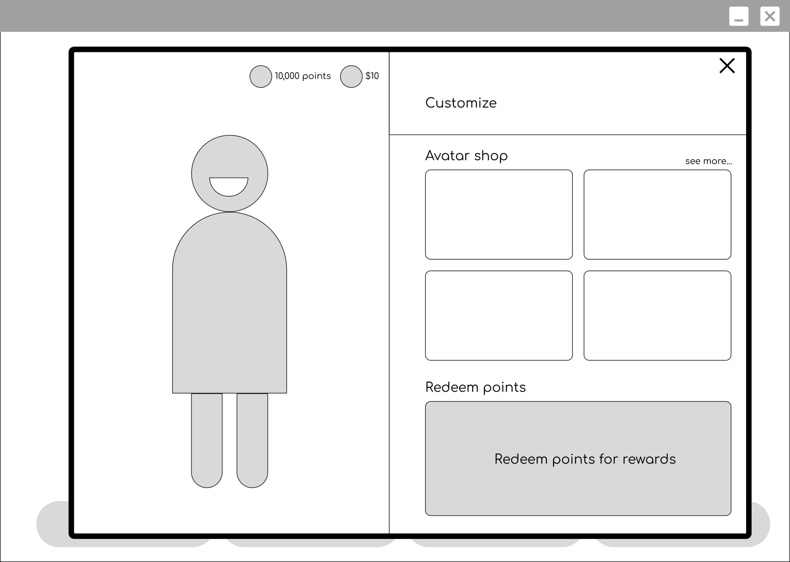
Customization
Customize
Users can use points they earn from being consistent with the app to purchase in-game items to customize their avatars. They can also convert their points into redeemable rewards like gift cards, in partnership with other businesses.
Avatar shop
Users can use points they earn to buy in-game items for their avatar
Avatars
Customizable avatars
Redeem points
Users will also have the option to redeem their points for real life prizes such as gift cards, products, or sweepstakes entries.

Slide 14
Link to prototype
https://www.figma.com/file/pWYiauW9gWG4PHx7PUCwM2/Lofi-Prototype?type=design&node-id=50%3A2&mode=design&t=kA08CKrJPkWtCUOs-1

Slide 15
Feedback Questions
How can we make the pop-up more effective? Is there any other information you would like to see there?
What improvements can we make to help motivate users stay consistent?
How do incentivize users to continue using the app even after they've developed the desired behavior and healthy habits? Is it even necessary to do so?

